Slide 1
REAL TIME CHAT APP
Submitted in the partial fulfillment for the award of the degree of
BACHELOR OF ENGINEERING
IN
INTERNET OF THINGS
Submitted by:
JANVI 20BCS4537
NIMISH SURI 20BCS4550
GAURAV MALIK 20BCS4573
SACHIN CHAUDHARY 20BCS4517
Under the Supervision of:
MR. DHAWAN SINGH
Department of AIT-CSE
DISCOVER . LEARN . EMPOWER

Slide 2

Outline
Introduction to Project
Problem Formulation
Objectives of the work
Methodology used
Results and Outputs
Conclusion
Future Scope
References

Slide 3
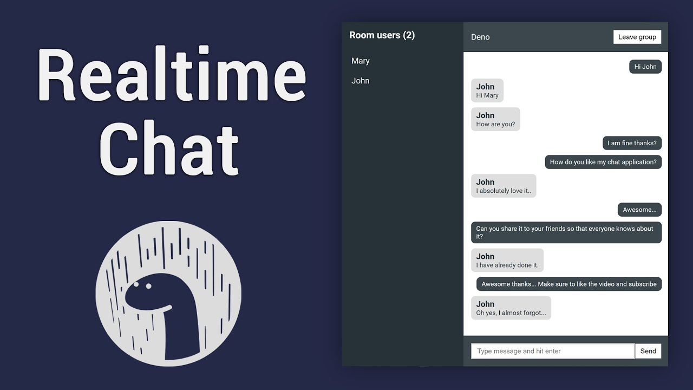
Introduction to Project
With the passage of time, the rapid advancement of information and communication technology is assuming an increasingly pivotal role in society. These technological innovations have granted people the ability to effortlessly retrieve information and engage in communication from virtually any location.
In the contemporary milieu, a considerable number of individuals have shifted their reliance on conventional outlets such as newspapers and television news channels. Instead, the majority now turn to intelligent technology, encompassing smartphones and other devices, to access a diverse array of information.

Slide 4

Introduction to Project
Chat applications have assumed a central role in this transformation. Individuals are progressively employing these platforms to exchange information and engage in discussions about current events, both locally and on a global scale. Nevertheless, these chat applications come accompanied by their unique set of pros and cons, mirroring the nature of technology in general. User feedback and their firsthand encounters with these applications play a pivotal role in aiding individuals in evaluating the essential features and areas that warrant enhancement.

Slide 5

Problem Formulation
This project is to create a chat application with a server and users to enable the users to chat with each other. To develop an instant messaging solution to enable users to seamlessly communicate with each other. The project should be very easy to use enabling even a novice person to use it. The development plan for our chat application involved creating a platform for users to communicate with each other in real-time using the MERN stack, which is a widely used and modern technology stack in the industry.

Slide 6

Objectives
The objectives of a real-time chat app can vary depending on the specific goals and requirements of the application and its users.
1. Instant Communication: Facilitate real-time, instant communication between users, enabling them to exchange messages quickly and efficiently.
2. User Engagement: Enhance user engagement by providing a platform for interactive and dynamic conversations.
3. Multi-Platform Accessibility: Ensure that the chat app is accessible across multiple platforms, including desktop, mobile, and web, to reach a broad user base.
4. Real-Time Updates: Provide real-time updates and notifications to keep users informed about new messages, ensuring a timely response.
5. User-Friendly Interface: Design an intuitive and user-friendly interface to make the chat experience seamless and enjoyable.

Slide 7
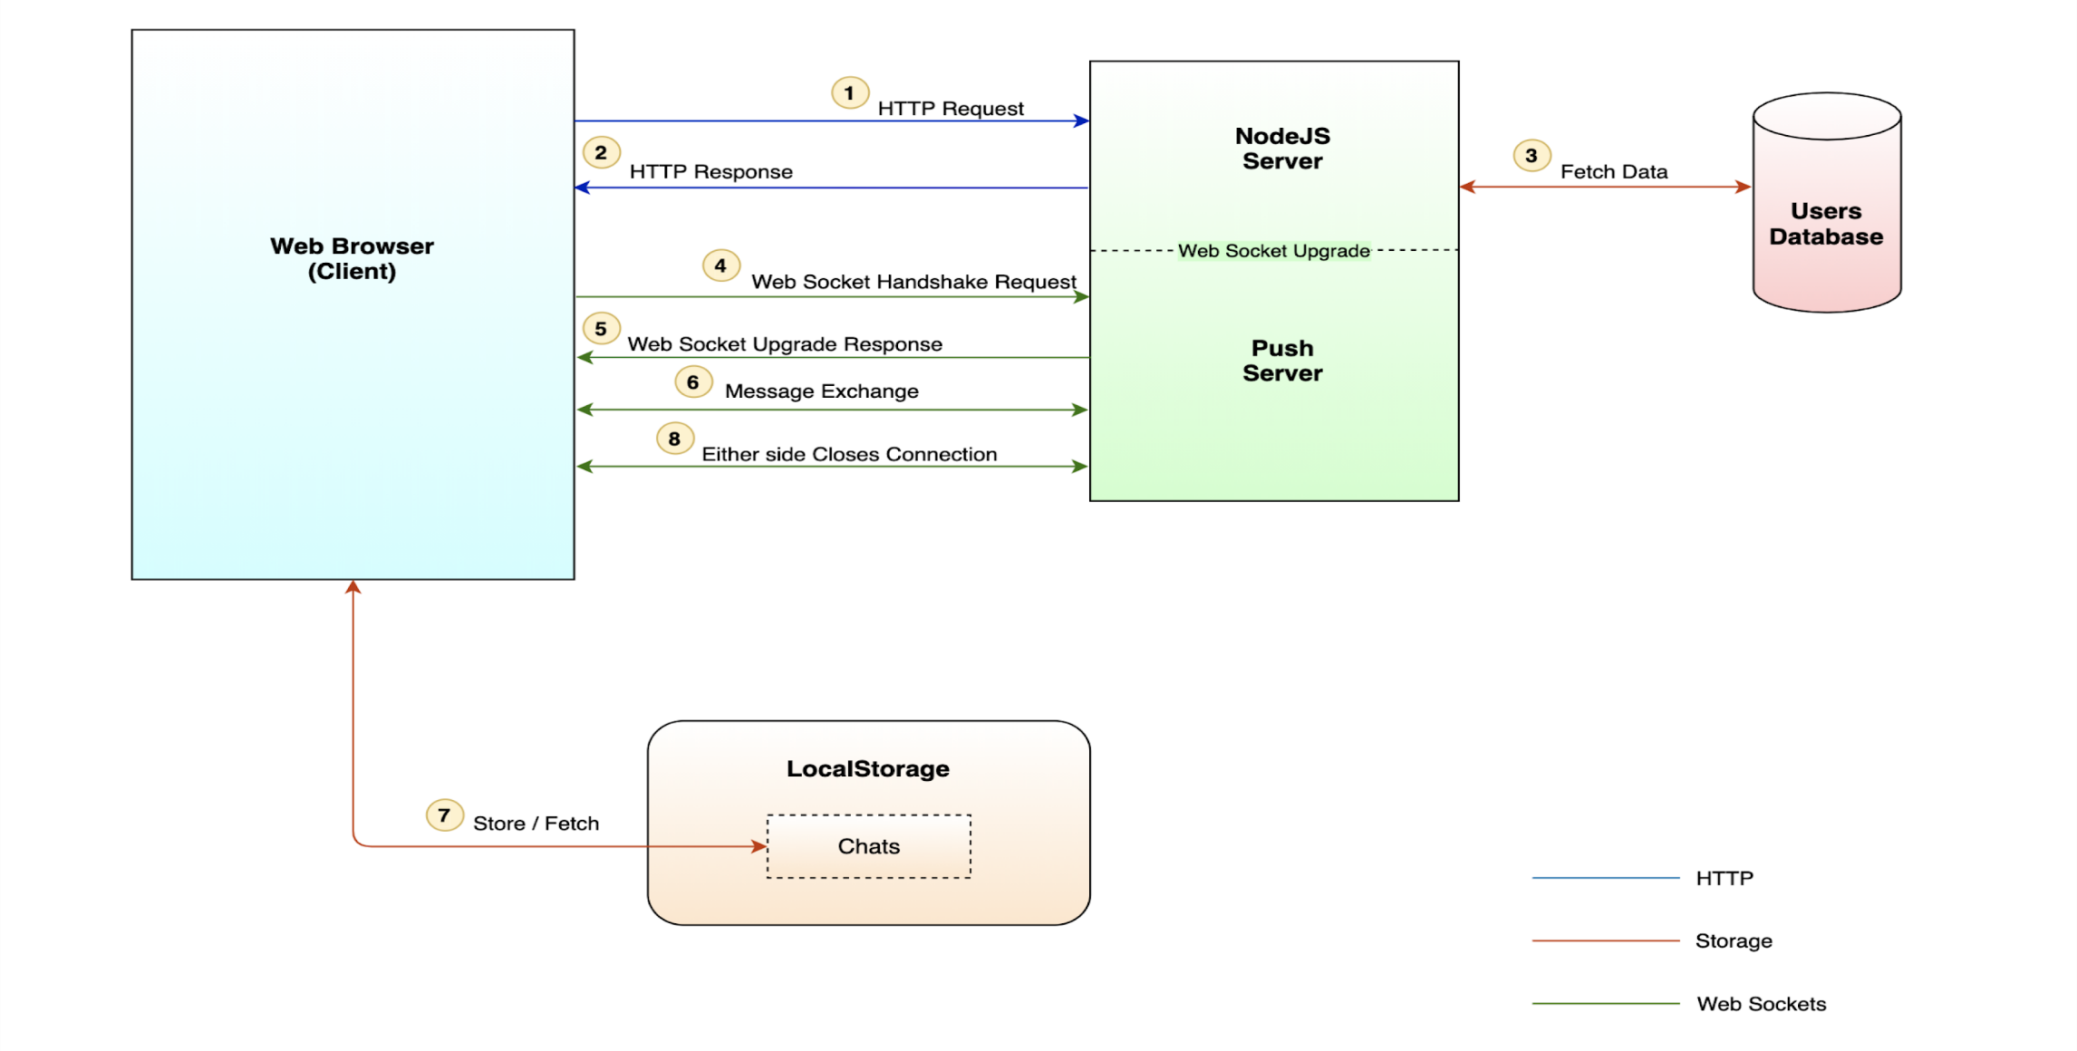
Methodology

Slide 8
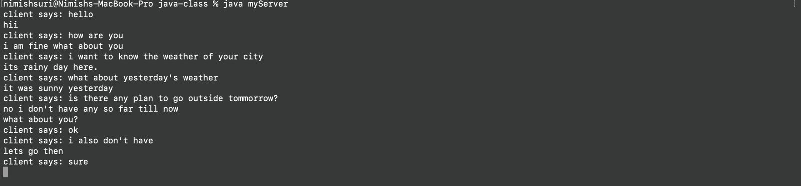
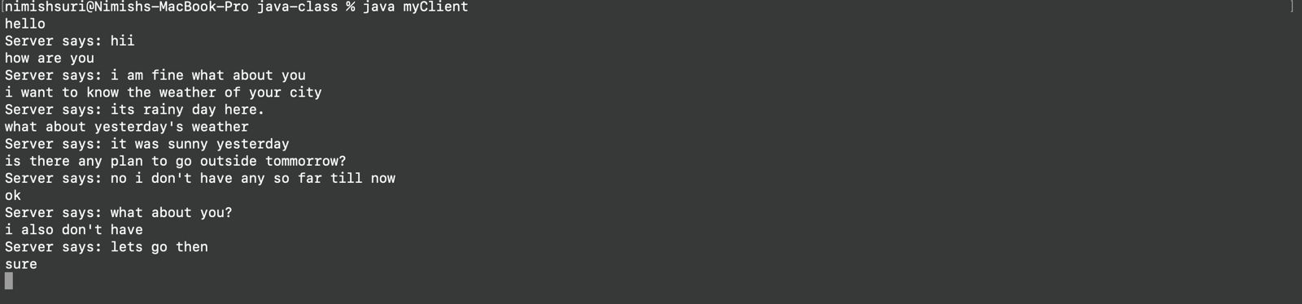
Results and Outputs

Slide 9
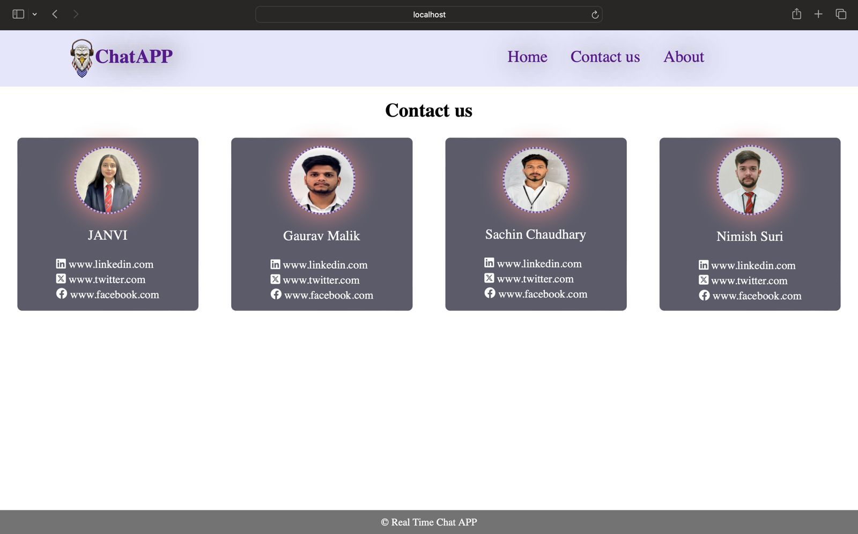
Results and Outputs

Slide 10
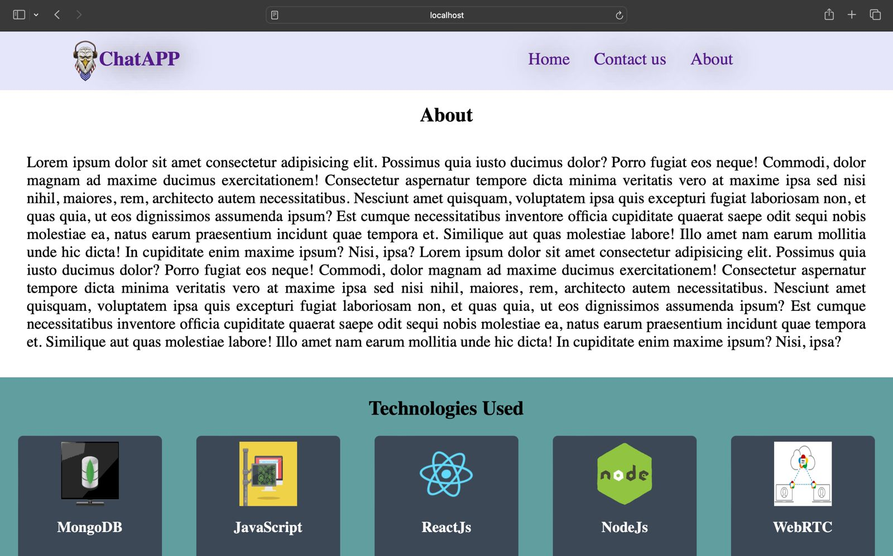
Results and Outputs

Slide 11
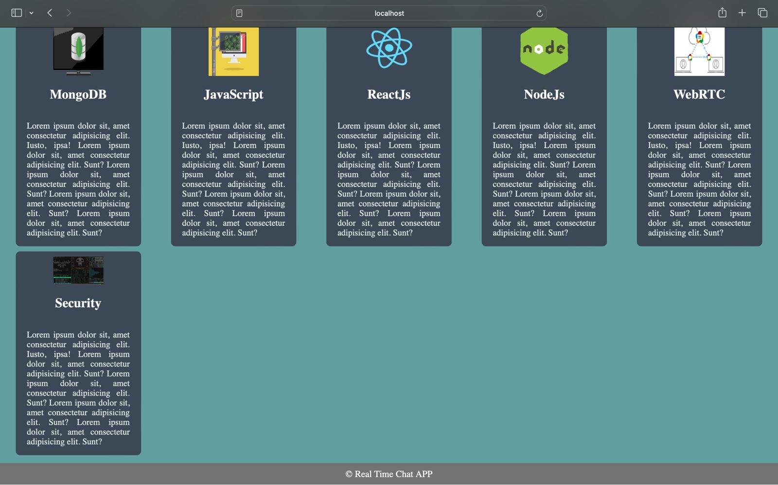
Results and Outputs

Slide 12

Conclusion
In conclusion, here are key points to consider:
Intuitive Interface: The app should have a user-friendly and intuitive interface to ensure users can easily navigate and use the chat features.
Real-Time Updates: Users expect instant message delivery and real-time updates. Implementing features like push notifications can enhance the user experience.
Encryption: Implement end-to-end encryption to secure communication between users. This ensures that only the intended recipients can read the messages.
Authentication: Use secure authentication mechanisms to verify the identity of users and prevent unauthorized access.

Slide 13

Future Scope
Here are some potential trends and directions for the future of real-time chat apps:
AI-Powered Chatbots: Integration of advanced AI chatbots for more intelligent and personalized interactions.
Multimedia Integration: Augmented Reality (AR) and Virtual Reality (VR) integration for immersive experiences.
Cross-Platform Compatibility: Seamless integration across various devices and platforms, ensuring users can chat effortlessly.
Voice and Video Calls: Improved quality and reliability of voice and video calls within chat apps.

Slide 14
References
https://www.researchgate.net/publication/370516068_Real-Time_Chat_Application
https://www.geeksforgeeks.org/real-time-chat-application-in-javascript/
https://www.irjmets.com/uploadedfiles/paper/volume_3/issue_12_december_2021/17504/final/fin_irjmets1639029715.pdf
https://ieeexplore.ieee.org/document/7849628
https://ijcrt.org/papers/IJCRT2303722.pdf
https://www.ijcaonline.org/archives/volume174/number30/sharma-2021-ijca-921240.pdf
https://www.researchgate.net/publication/332264701_Android_based_instant_messaging_application_using_firebase

